Slide 1
Integrated Data Analysis for Transportation Safety Enhancement Presentation

Slide 2
Project analysis slide 2
GROUP-1
DIYA VALAND
CLASSIFICATION
Team Members& Roles
HARSIMRANJIT SINGH
CLUSTERING
ARSHPREET KAUR
OUTLIER DETECTION

Slide 3

“What are the contributing factors for the collision to end up in fatality and in which season Ottawa face most Collisions?”

Slide 4
BusinessUnderstanding
Our project seeks to analyze the 2020 Tabular Transportation Collision Data from Ottawa with the overarching goal of enhancing transportation safety. By dissecting the underlying factors influencing collision occurrences and outcomes, we aim to provide stakeholders with actionable intelligence to reduce collision rates, mitigate injury severity, and improve overall road safety. Through collaborative efforts grounded in methodological rigor and effective communication, we endeavor to deliver a comprehensive analysis that empowers stakeholders to foster a safer and more resilient transportation ecosystem in Ottawa and answer the question,
“What are the contributing factors for the collision to end up in fatality and in which season Ottawa face most Collisions?”

Slide 5
Project analysis slide 3
Data Understanding
COLLECT DATA
To collect data from this dataset, researchers or analysts can access the dataset through the provided 2020 Tabular Transportation Collision Data | Open Ottawa and extract the relevant information based on their research or analysis objectives.
DESCRIBE DATA
EXPLORE DATA
VERIFY DATA QUALITY
The dataset contains 10047 instances with 28 attributes related to 2020 Tabular Transportation Collision Data with data type nominal, integer, date-time and real.
Data exploration is an iterative and interactive process, where insights gained at one step may prompt further questions or lead to deeper dives into specific areas of the dataset.
To verify data quality, we must ensure the accuracy, completeness, and reliability of the 2020 Tabular Transportation Collision Data from Ottawa.

Slide 6
Project analysis slide 3
Data Preparation
CLEAN DATA
SELECT DATA
By accessing data quality, handling missing values (here we are replacing missing values in max_injury by unknown), and normalizing data (to ensure that all attributes are on a similar scale), although we don’t have any duplicates to remove.
CONSTRUCT DATA
INTEGRATE DATA
FORMAT DATA
We will use all 10047 instances in the dataset, with no exclusions, but choose only the following 12 attributes for analysis.
We are grouping months to 4 weather seasons and split Accident_Date to 3 different columns..
Integrate data is process of combining data of various sources, but we are not comparing our data to any other sources..
In this part, we format data to use data for the remaining parts.

Slide 7
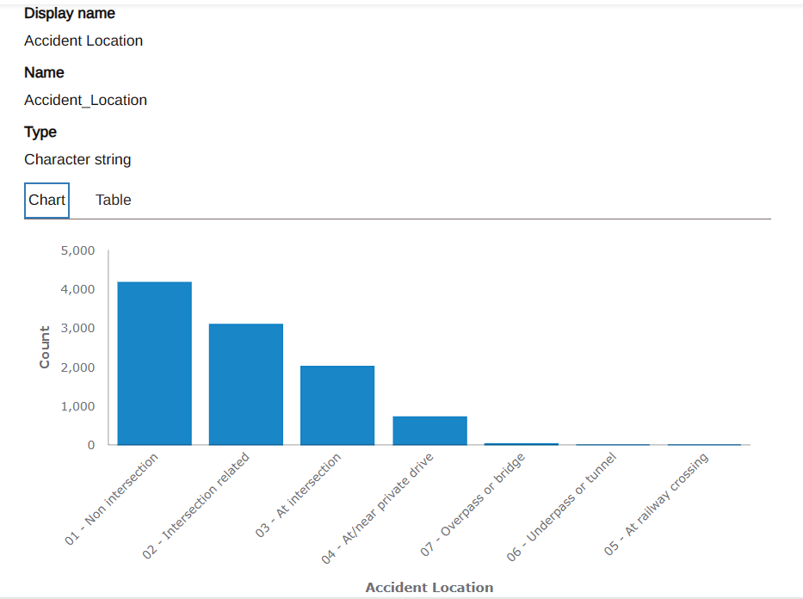
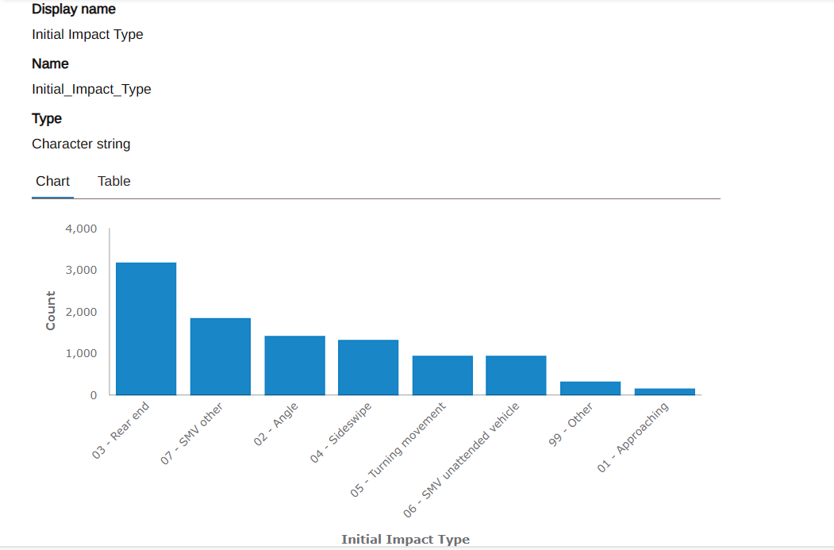
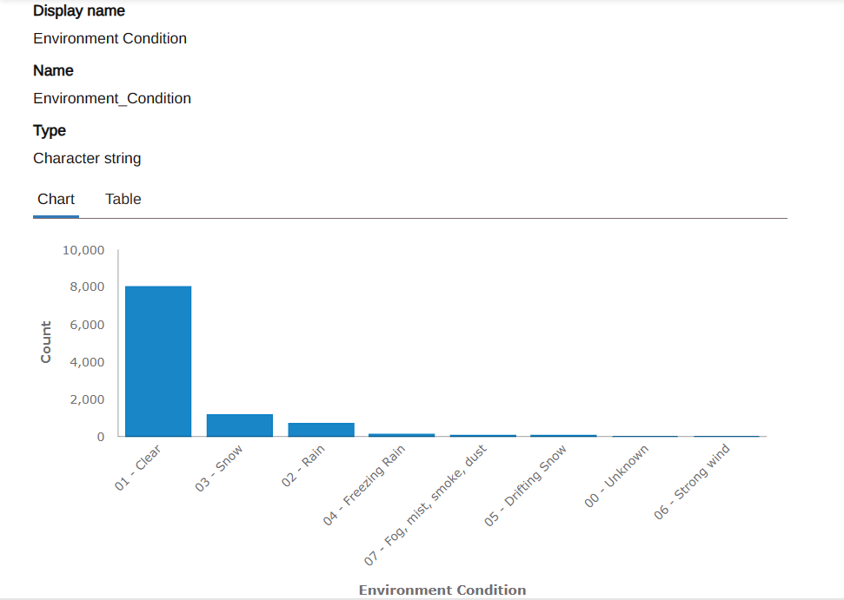
Explore Data Graphs
These are some graphs that is part of data exploration part. These graphs are Accident Location, Environment Condition etc.

Slide 8
Classification

Slide 9
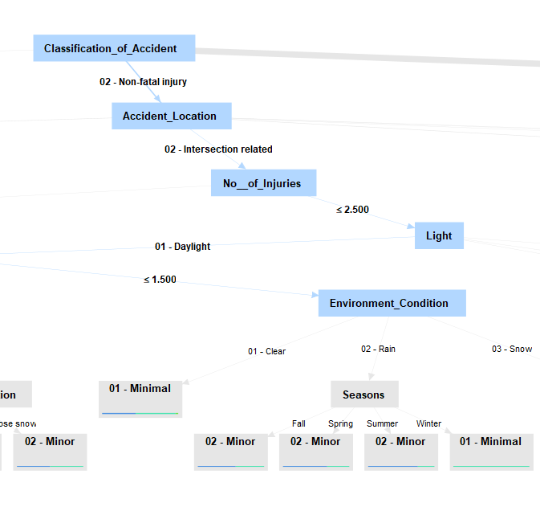
Decision Tree
DESCRIPTION
This decision tree, visualized in RapidMiner, represents a predictive model for classifying road accidents. At the first level, accidents are categorized as "02 - Non-fatal injury", with subsequent nodes stratifying the data based on "Accident_Location" and "No_of_Injuries", which then leads to further classification influenced by "Environment_Condition" and "Seasons". The terminal nodes of the tree indicate the severity of the accidents as "Minimal" or "Minor", providing insight into the contributing factors of road accidents under various conditions.

Slide 10
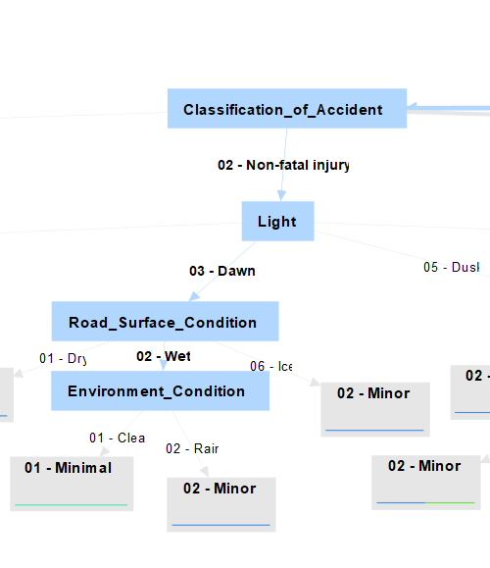
.
Random Forest
DESCRIPTION
The image represents a decision tree used within a Random Forest model for categorizing non-fatal intersection-related traffic accidents. The decision process involves bifurcating by the number of injuries, and further by environmental conditions and seasons, to predict the severity of the accidents as either "Minimal" or "Minor". This tree is likely one of many in the Random Forest ensemble, each contributing to a collective decision-making process.

Slide 11
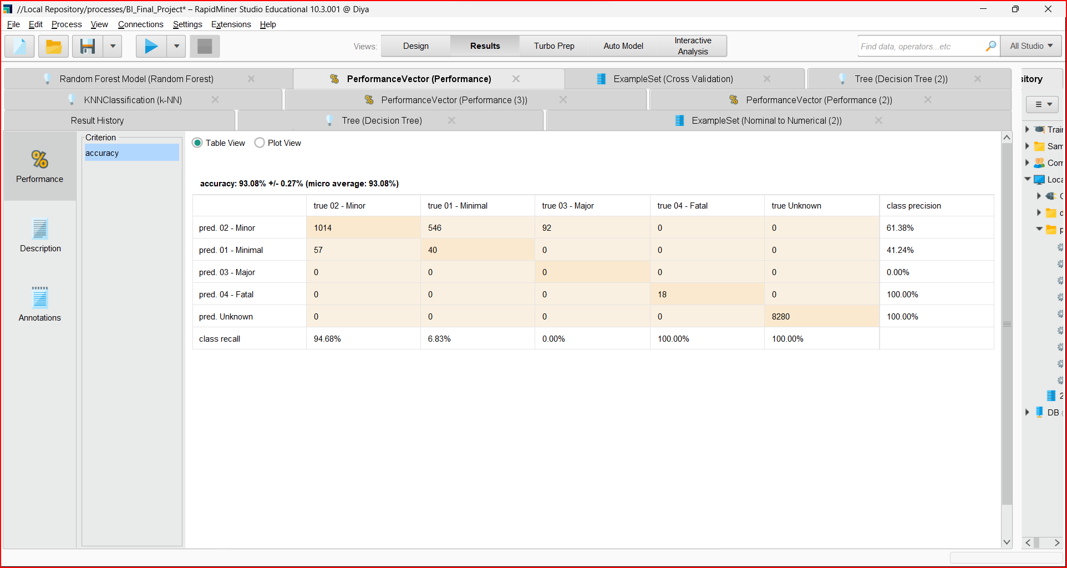
Cross Validation
The screenshot depicts a confusion matrix from RapidMiner, displaying the performance of a predictive model with an overall accuracy of 93.08%. The matrix reveals high precision in predicting 'Fatal' and 'Unknown' classes at 100%, with The majority of predictions concentrated in the 'Minor' injury class.

Slide 12
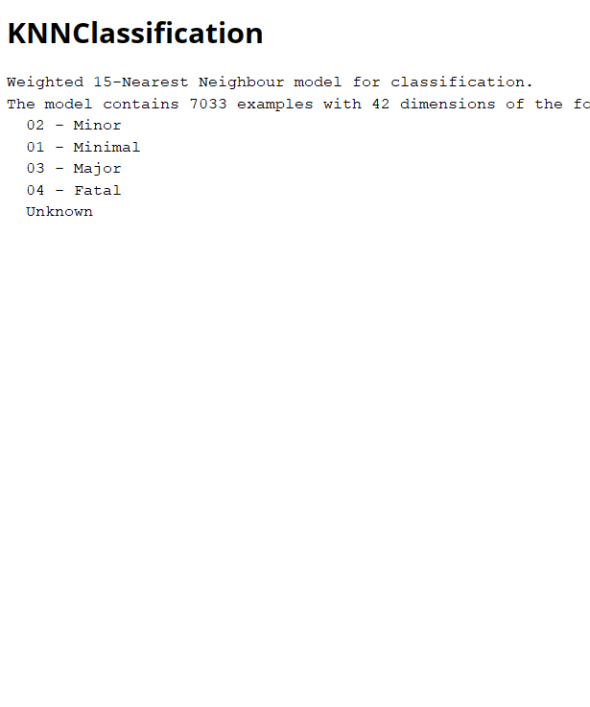
.
KNN Classification
The KNN Classification model described is a Weighted 15-Nearest Neighbour algorithm configured to classify data into five categories, ranging from 'Minimal' to 'Fatal' injuries, using a dataset of 7033 examples, each with 42 features. This model assigns class labels based on the weighted influence of the 15 closest training examples in the feature space.

Slide 13
Clustering

Slide 14
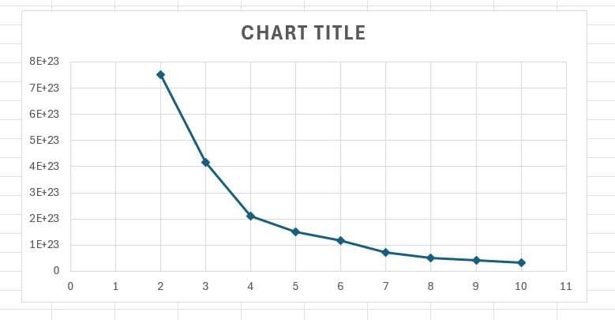
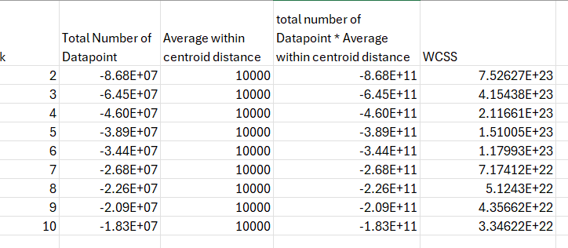
.
Elbow Method
Formatted data using "Numeric to Nominal" for clustering algorithms that need numerical data.
Use the Loop Parameter
Set k-means parameters with a minimum of 2 and a maximum of 10 clusters to start the analysis.
Executed the Loop Parameter to get results for k and the average distance to centroids.
Plotted the Within-Cluster Sum of Squares (WCSS) against different k values to find the Elbow Point.
Determined that K=4 is the optimal number of clusters for stability and will be used for further clustering and outlier detection.

Slide 15
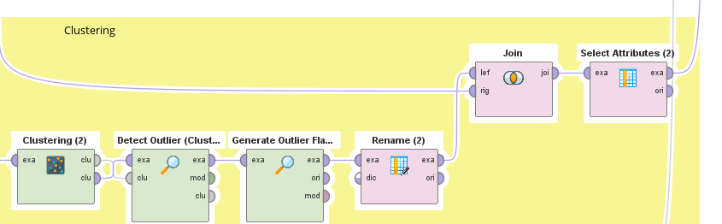
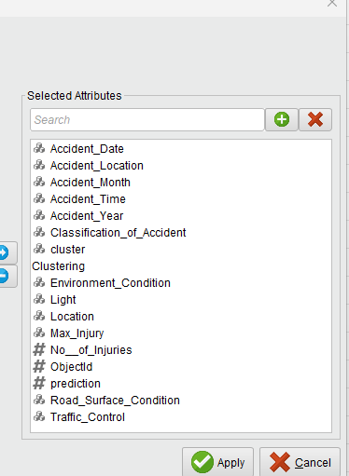
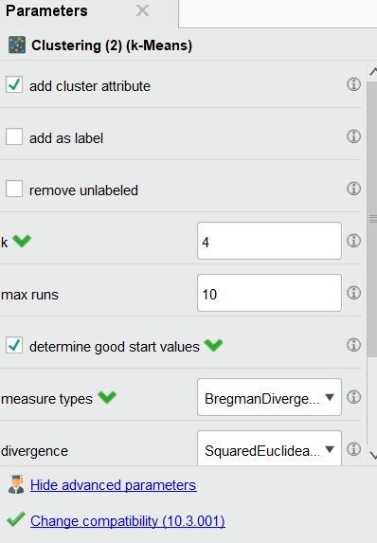
K-mean Clustering
Used "Nominal to Numeric Operator" to prepare the data for K-means clustering.
Set K=4 in the K-means Clustering operator based on the elbow method's outcome.
Applied "Detect Outlier (Clustering)" operator with default settings.
Integrated "Generate Outlier Flag" to identify outliers.
Renamed outlier flag to "Clustering Outlier" using the "Rename" operator.
Combined clustered and prepared data using the "Join" operator.
Selected specific attributes related to accident conditions using the "Select Attribute" operator.

Slide 16
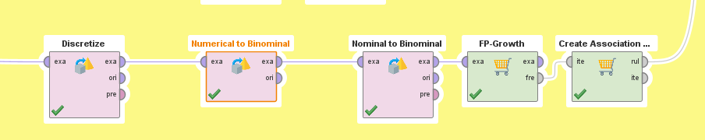
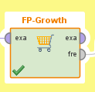
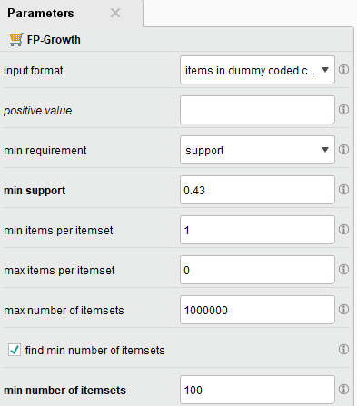
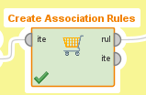
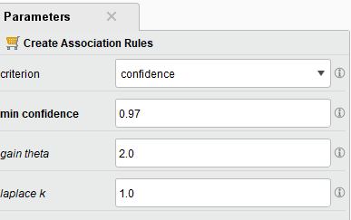
.
Association
Opted for the FP-Growth algorithm over Apriori for association rule mining.
Applied "Discretize (by frequency)" with the number of bins set to 2.
Formatted data using "Numeric to Binominal" and "Nominal to Binominal" for compatibility with FP-Growth.
Set FP-Growth operator's minimum support to 0.43.
Configured "Create Association Rule" operator with a minimum confidence of 0.97.

Slide 17
Outlier Detection

Slide 18
Outlier Detection
Outlier detection is a fundamental step in data analysis, focusing on identifying data points that significantly deviate from the majority. Here are five concise points summarizing its essence:
Objective: To pinpoint anomalies in data that may represent errors, extreme values, or rare occurrences, impacting analysis results.
Methods: Utilizes a range of techniques including statistical tests, proximity-based algorithms like the Local Outlier Factor, and ensemble methods like Isolation Forest, depending on data characteristics.
Importance: Essential for ensuring accurate analysis, as outliers can skew results and mislead conclusions, especially in predictive modeling and fields like fraud detection.
Challenges: Distinguishing between mere noise and genuine outliers is complex, with detection efficacy often hindered by data dimensionality and varying definitions of outliers across contexts.
Outcomes: Following detection, actions may include deeper investigation, data exclusion, or adapted analysis strategies, all critical for drawing reliable conclusions from data.

Slide 19
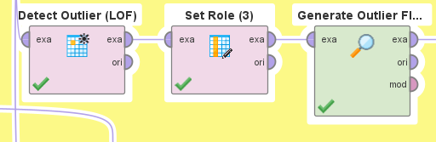
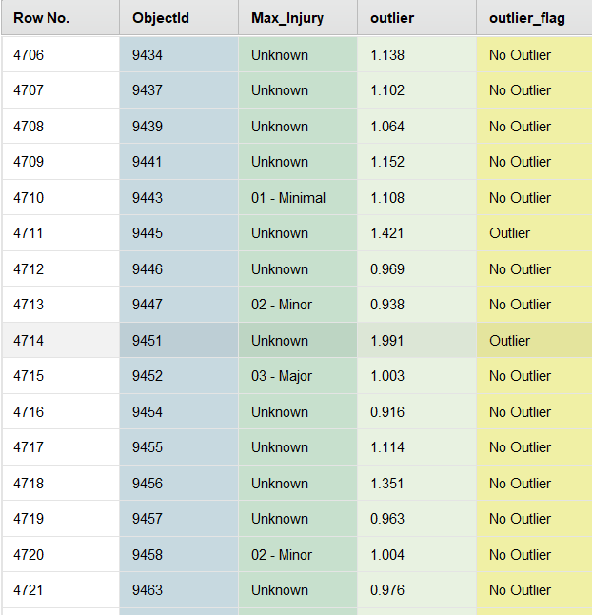
LOF
SCREENSHOT
DESCRIPTION
This operator identifies outliers in the given ExampleSet based on local outlier factors (LOF). The LOF is based on a concept of a local density, whose distance is used to estimate the density. By comparing the local density of an object to the local densities of its neighbors, one can identify regions of similar density, and points that have a substantially lower density than their neighbors. These are considered to be outliers
Generate Outlier Flag-
Method - Contamination Method ,
Score Column - Outlier
Contamination Threshold - 0.05.

Slide 20
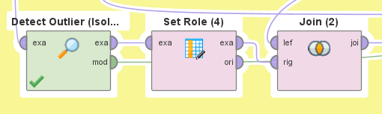
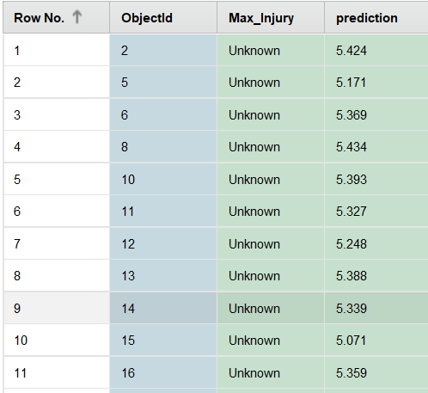
ISF
SCREENSHOT
DESCRIPTION
Isolation Forests are anomaly detection algorithms. Unlike normal Random Forests they do not need any label to work on. Their purpose is to detect if data points are similar to the training data or not.
Number of trees – 1000
Max leaf size - 2
Bootstrap ratio - 0.9
Score calculation done by average_path.

Slide 21
Results

Slide 22
Classification
From the Classification Methods it is clear that most collisions in Ottawa occur –
At Intersection
At Wet Road Surface
In Winter Season

Slide 23
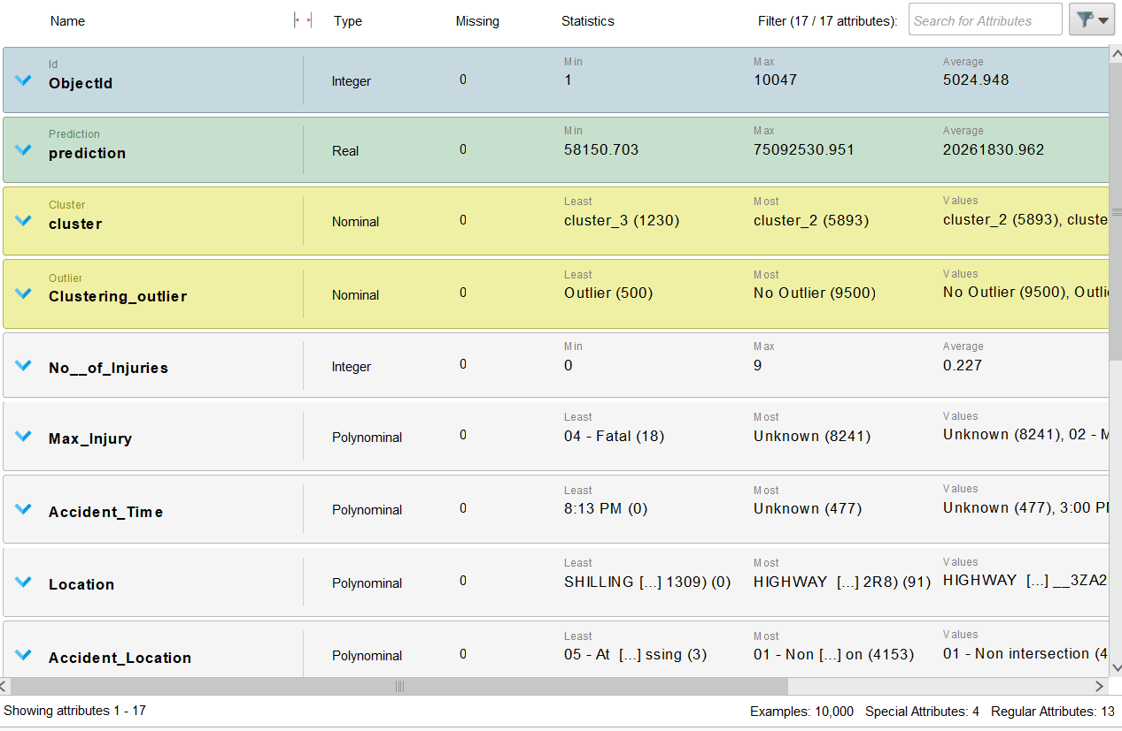
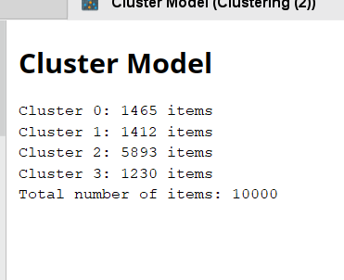
.
Clustering
Cluster Name: Cluster_0
Description: This cluster primarily comprises traffic incidents resulting in property damage without major injuries. Most incidents occurred at non-intersections during clear weather, although snow and slushy conditions are also noted. Accidents were evenly spread throughout the day, with a considerable number occurring in the evening. Many locations lacked formal traffic control, potentially contributing to the incidents. Data from January 2020 indicated minimal to minor injuries reported
Key Characteristics:
Primary Outcome: Property damage with minimal to minor injuries.
Incident Locations: Non-intersections, with some incidents occurring during clear weather, and others during snow and slushy conditions.
Time Distribution: Even distribution throughout the day, with a notable concentration in the evening.
Traffic Control: Many locations lacked formal traffic control measures
Potential Causes: Lack of formal traffic control, potential negligence or recklessness in driving behavior

Slide 24
.
Clustering
Cluster Name: Cluster_1
Description: This cluster encompasses traffic incidents with a range of injury severities, including minor and major injuries. Most incidents occurred in clear weather conditions throughout various times of the day. The incidents occur both at intersections and non-intersections, with many areas lacking formal traffic control measures. The data spans January 2020.
Key Characteristics:
Injury Severity: Range of severities, including minor and major injuries.
Weather Conditions: Clear weather predominates during incidents.
Time Distribution: Occurrences are spread across various times of the day.
Incident Locations: Both intersections and non-intersections are involved, with many areas lacking formal traffic control.
Potential Causes: Factors contributing to incidents may include varying weather conditions, lack of traffic control, and potentially negligent or reckless driving behaviors.

Slide 25
.
Clustering
Cluster Name: Cluster_2
Description: This cluster comprises traffic incidents primarily involving unknown injuries. The incidents occur across various times of the day, predominantly in clear weather and daylight conditions. They are distributed between intersections with traffic control and non-intersections without control, indicating a mix of potentially risky locations. Instances of minor injuries and minimal damage are noted, with a few outliers identified, suggesting exceptional cases within this cluster. The data is from January 2020.
Key Characteristics:
Injury Status: Mainly unknown injuries.
Weather and Time: Predominantly clear weather and daylight conditions, occurring across various times of the day.
Incident Locations: Spread between intersections with traffic control and non-intersections without control, indicating a mix of potentially risky locations.
Injury Severity and Damage: Instances of minor injuries and minimal damage, with some outliers indicating exceptional cases.
Potential Causes: Factors contributing to incidents may include varying road conditions, driver behavior, and potentially unpredictable circumstances.

Slide 26
.
Clustering
Cluster Name: Cluster_3
Description: Cluster_3 encompasses traffic incidents primarily characterized by unknown injury severity. These incidents occur under various conditions, with a significant portion happening in clear weather and a mix of daylight, dusk, and dark conditions. They are distributed between controlled intersections and areas with no control, including many near private drives, indicating different risk points. Frequent occurrences of snow and wet conditions suggest potential weather-related driving hazards. The data spans January 2020, with incidents occurring across all times of the day
Key Characteristics:
Injury Severity: Largely unknown injury severity.
Weather and Time: Varied conditions including clear weather, daylight, dusk, and dark conditions. Incidents occur across all times of the day.
Incident Locations: Split between controlled intersections and areas with no control, including those near private drives, suggesting different risk points.
Weather Conditions: Frequent occurrences of snow and wet conditions, indicating potential weather-related driving hazards.
Potential Causes: Factors contributing to incidents may include varied road and weather conditions, as well as the presence of intersections with differing levels of traffic control.

Slide 27
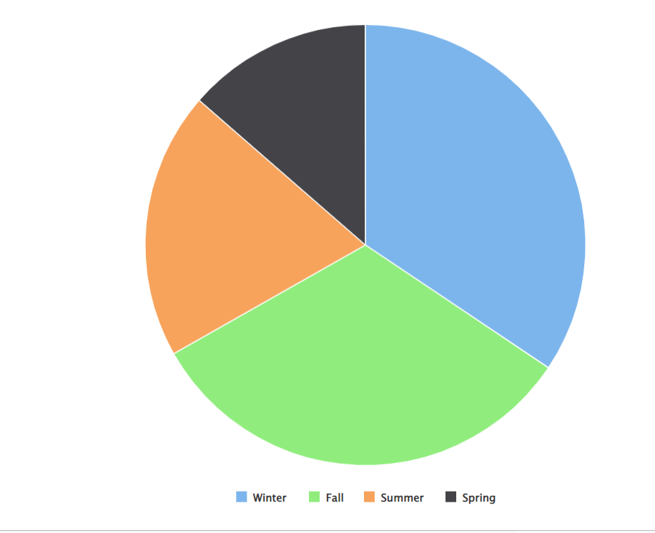
Outlier Detection-
Winter has the most outliers: This suggests a possible increase in anomalies during colder months.
Fall is second in outlier count: Indicating a lesser but still significant presence of anomalies.
Summer and Spring have fewer outliers: With Spring having the least, implying that warmer months have fewer anomalies.
Potential Seasonal Impact: The trend suggests the influence of seasonal factors on the data.
Modeling Consideration: Adjustments for seasonality may be necessary in predictive modeling.

Slide 28
Project analysis slide 10
Result Analysis
This screenshot shows working with the RapidMiner Studio application. The interface displays results from different machine learning models— Decision Tree, k-NN (k-Nearest Neighbors), and Random Forest—comparing their performance metrics such as accuracy and confusion matrices.
To lower crash rates and raise road safety in Ottawa, specific interventions and infrastructure upgrades can be guided by the findings from clustering analysis, outlier detection and classification models.

Slide 29
Thank You

